Slide 1
Real-time integrated prefetching and caching
Peter Sanders∗
Johannes Singler∗
Rob van Stee†
September 26, 2012

Slide 2
Agenda
Intro: Caching and Prefetching, Why and when
The problem
Eager-LFD
Lazy-LFD
Online algorithms

Slide 3
Intro
What is caching?
What is prefetching?
Why and when to use?

Slide 4
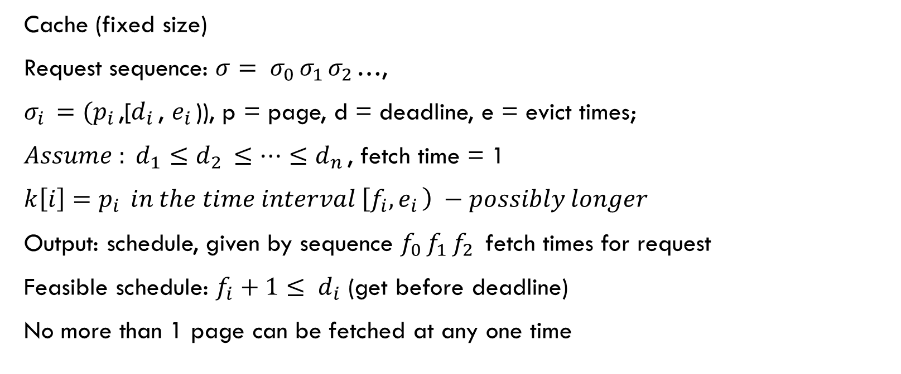
The problem - elements
Cache (fixed size)
Request sequence: $σ= σ_{0 }σ_{1 }σ_{2 }$…,
$σ_{i }=(p_{i }$,[$d_{i }$, $e_{i }$)), p = page, d = deadline, e = evict times;
$Assume {: d}_{1 }≤d_{2 }≤…≤d_{n }$, fetch time = 1
${k\left[i\right]=p}_{i } in the time interval \left[f_{i},e_{i }\right) −possibly longer$
Output: schedule, given by sequence $f_{0 }f_{1 }f_{2 }$ fetch times for request
Feasible schedule: $f_{i}+1≤ d_{i}$ (get before deadline)
No more than 1 page can be fetched at any one time

Slide 5
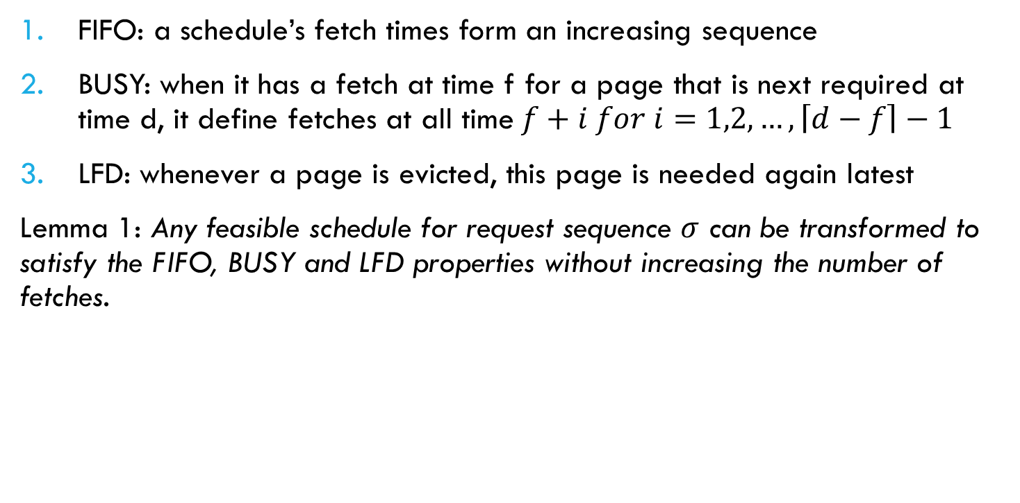
The problem – properties:
FIFO: a schedule’s fetch times form an increasing sequence
BUSY: when it has a fetch at time f for a page that is next required at time d, it define fetches at all time$f+i for i=1,2,…,\left\lceil d−f\right\rceil −1$
LFD: whenever a page is evicted, this page is needed again latest
Lemma 1: Any feasible schedule for request sequence $σ$ can be transformed to satisfy the FIFO, BUSY and LFD properties without increasing the number of fetches.
Notes:
1 -> se dem prin interschimbare; 2-> delay fetch until right before requested; 3-> swap evictions

Slide 6
Eager-LFD
Eager-LFD is a real-time offline prefetching algorithm which computes a feasible schedule if there exists one.
EAGER-LFD needs at most twice the number of I/Os than an optimal algorithm.
+ Easy to implement efficiently – O(n log n)
Notes:
Example compares Eager (black) with optimal (green). Cache size = 2, a, b,c = pages; BOLD proof -> induction

Slide 7
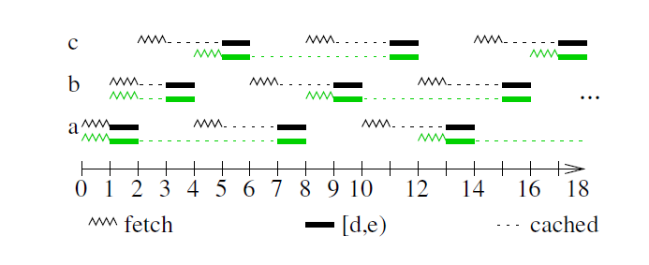
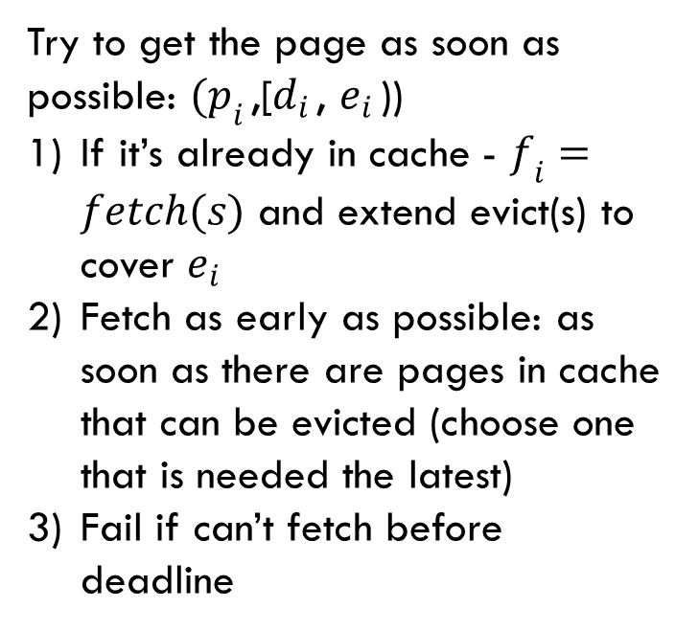
Eager-LFD
Try to get the page as soon as possible: $(p_{i }$,[$d_{i }$, $e_{i }$))
If it’s already in cache - $f_{i}=fetch(s)$ and extend evict(s) to cover $e_{i}$
Fetch as early as possible: as soon as there are pages in cache that can be evicted (choose one that is needed the latest)
Fail if can’t fetch before deadline
Cache size: 2
Notes:
Example compares Eager (black) with optimal (green). Cache size = 2, a, b,c = pages; BOLD proof -> induction

Slide 8
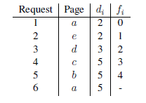
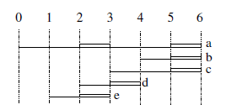
Lazy-LFD
Construct fetching starting backwards from the last deadline. Track the time at which the earliest fetch is needed. For each new requests (incoming requests), check to see if there is room in cache to hold page and extend the evict time.
The FIFO, BUSY and LFD properties hold throughout the execution
If there exists a feasible schedule, LAZY-LFD computes an I/O-optimal one.
Notes:
Tight fetch -> just before deadline (latest possible time).
Slack of a fetch -> time between end of fetch and deadline.

Slide 9
Lazy-LFD Optimal? -
Induction - Properties to hold at each step:
I/O-opt – does not define more than the optimal number of fetches
Lazy – the fetch cannot start later in any feasible schedule that satisfies FIFO and BUSY
Feasible
Min – at any time, an algorithm which is feasible and I/O optimal cannot keep less pages in its cache than LAZY-LFD

Slide 10
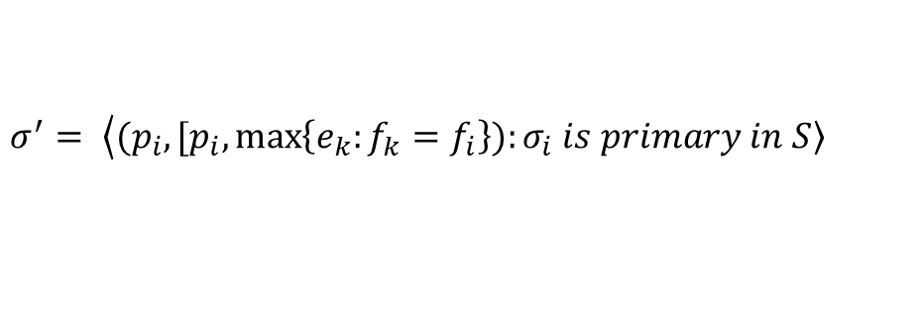
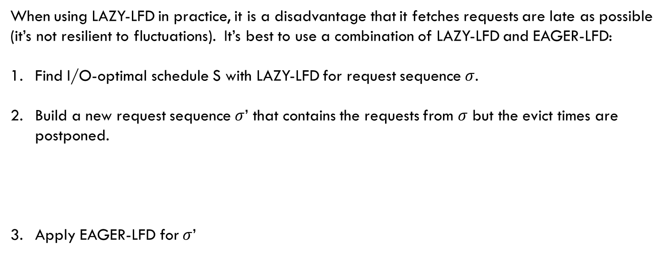
Lazy-LFD Optimal?
When using LAZY-LFD in practice, it is a disadvantage that it fetches requests are late as possible (it’s not resilient to fluctuations). It’s best to use a combination of LAZY-LFD and EAGER-LFD:
Find I/O-optimal schedule S with LAZY-LFD for request sequence $σ$.
Build a new request sequence $σ$’ that contains the requests from $σ$ but the evict times are postponed.
Apply EAGER-LFD for $σ$’
$$σ^{′}= \left\langle (p_{i}, [p_{i},\max\left\{e_{k}:f_{k}=f_{i}\right\})\right.:\left.σ_{i} is primary in S\right\rangle$$

Slide 11
Online algorithms
Any finite amount of lookahead is insufficient by itself to provide feasible schedules.
? larger cache – delaying the problem
Offline Solution(limitation: lookahead = k)? Fetch pages faster.
No pages are evicted during a fetch (A1)
At most one page is evicted at the start of a fetch (A2)
Pages are evicted only at the start of fetches.
There can be at most k + n - 1 requests for distinct pages. (upper bound)
Notes:
1- at some point, the algorithm has to decide what page to remove, and it has not enough info.
A2,A3 – keep cache as full as possible.
Solutia este o trecere de la offline la online.

Slide 12
Online algorithm – greedy solution
At each time t, do the following.
If there is any page p in the cache that is not currently needed and that is not visible in the lookahead, evict p.
If a request for page p becomes visible, schedule page p to be loaded at the earliest time at or after t at which there is a free slot in the cache.
Load any pages that are scheduled to be loaded at time t.
Greedy with a speed of s (i.e., that needs only 1/s time units for each page fetch) and a lookahead of k/(s − 1) creates a feasible schedule for each input for which a feasible schedule exists.

